Slide 1


Project
XVH
B2 - English - Practical
XVH-project@gmail.com
XVH-project.com

Slide 2
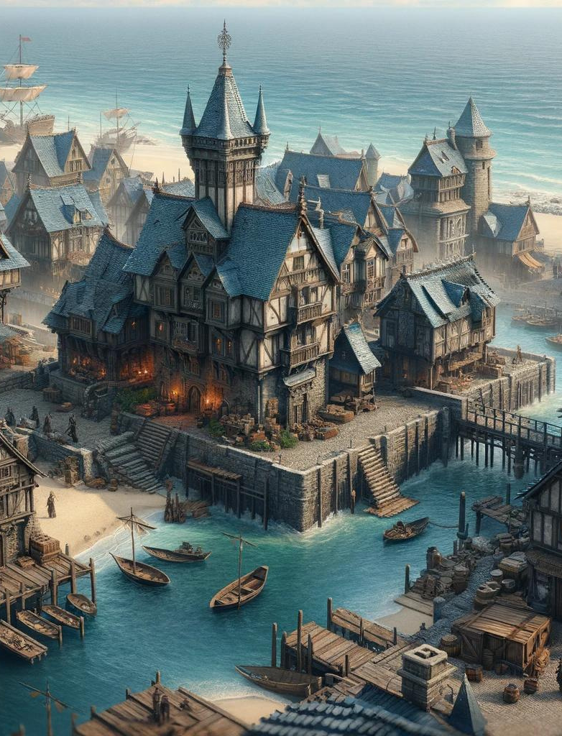
Introduction
Presentation Overview
New benchmark for immersive experiences.
Our game, 'XVH', is designed to captivate, engage, and revolutionize the way players interact within virtual worlds.

Slide 3




Project XVH
Our team
Alex Johnson
Raj Patel
Lead Developer: Formerly with AAA studios, Alex brings unparalleled coding prowess.
AI Specialist: Raj ensures our AI systems are both innovative and responsive, enhancing player interactions.
Maria Lee
Sophie Chen
Creative Director: A VR design virtuoso, Maria shapes the visual and sensory
Marketing Lead: With her experience at top tech firms, Sophie devises strategies that resonate with our audience.

Slide 4
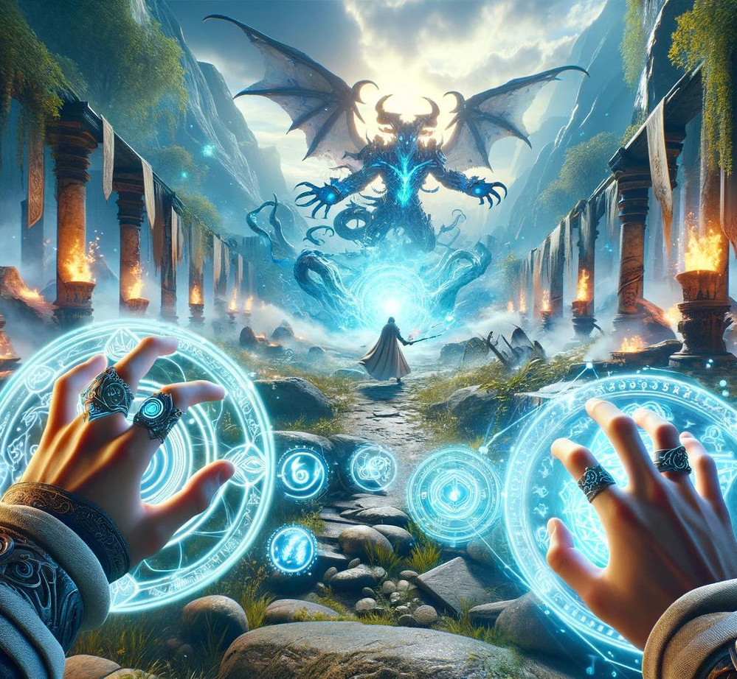
Project ‘XVH’ game:
open-world, multiplayer
VR game
PvP and PvE system
Understanding Project
XVH
The background:
conceived to overcome traditional gaming limitations.
Inspired by the giants of open-world gaming

Slide 5
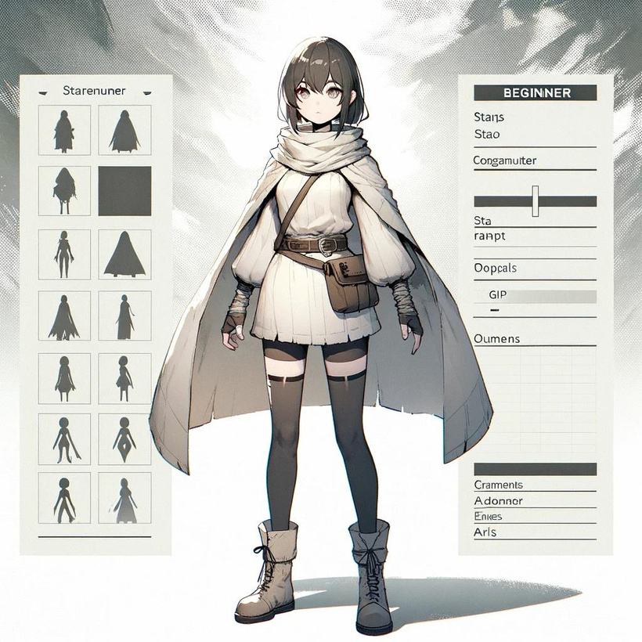
What Makes 'XVH' Unique
‘XVH' sets itself apart with its total immersion in a vast, open, multiplayer world. The seamless integration of PvP and PvE elements, combined with state-of-the-art VR technology, offers a unique value proposition in the burgeoning VR market.

Slide 6


Marketing and Sales
Our go-to-market strategy involves targeted online campaigns, engagement on social networks and VR forums, and partnerships with leading VR hardware manufacturers. 'XVH' will be available on major VR platforms, ensuring wide accessibility and significant market penetration.

Slide 7

Conclusion
In conclusion, 'XVH' represents not just a game, but a pioneering platform in the evolution of virtual reality entertainment. With its innovative features and strategic market positioning, 'XVH' is poised to capture the hearts of gamers worldwide. We are here not only to present a game but to invite you to join us in shaping the future of gaming.

Slide 8
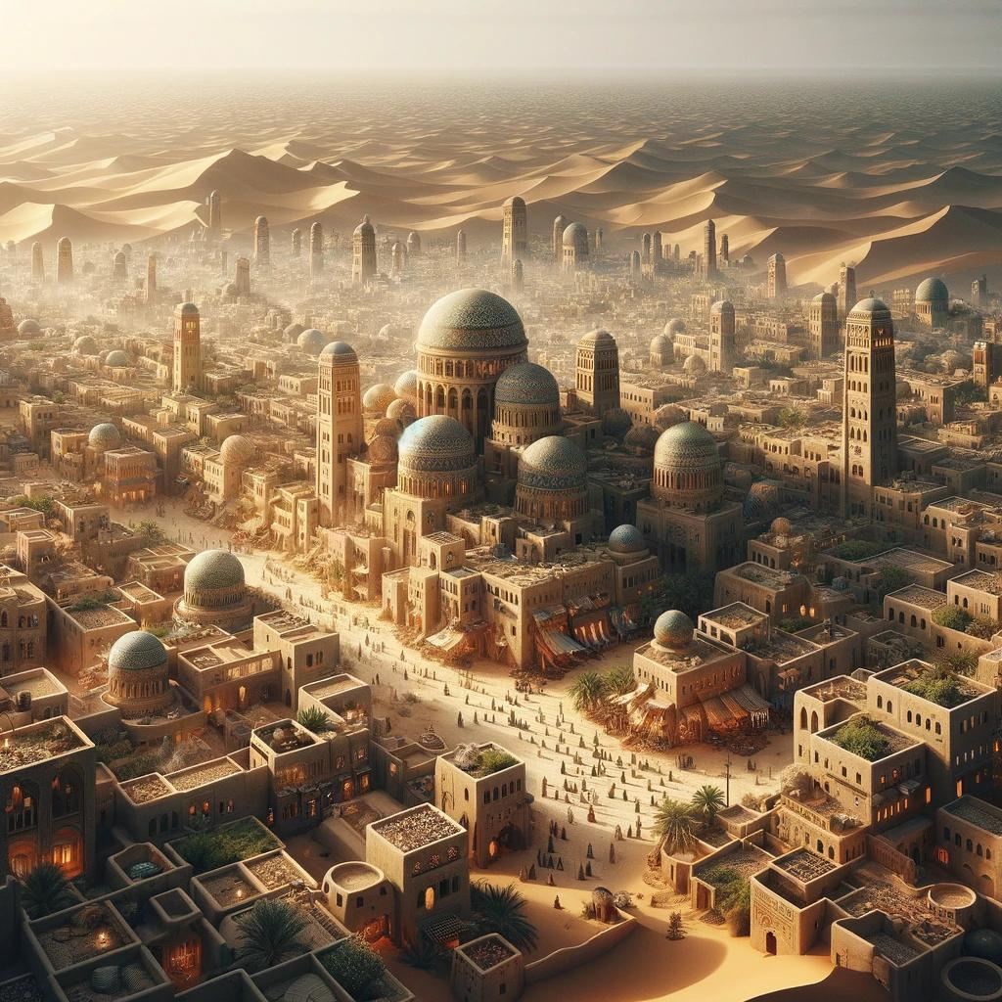
Thank You
For Your Attention

